Slide 1


HawkEye: Revolutionizing Cybersecurity for Small and Medium-sized Business(SMB)
211042 Noman Masood Khan A
211064 Hamza Haroon A
211961 Mazhar

Slide 2
Identifying the Problem and Opportunity
HawkEye simplifies cybersecurity by automating threat detection and visualization in evolving cyber landscapes.
This presentation will explore the development of HawkEye, from problem identification to market launch strategy
Also showcasing how it aims to provide access to sophisticated threat-hunting tools for small and medium-sized businesses.

Slide 3
Identifying the Problem and Opportunity
The Problem
The Opportunity
Traditional tools for network traffic analysis are complex and time-consuming, making them impractical for incident response
Security analysts spend excessive time manually sifting through PCAP files, delaying response to critical security incidents.
They also lack the GUI functionalities for the threat hunting.
Market research revealed a gap in affordable, user-friendly cybersecurity tools for small and medium-sized businesses (SMBs).
HawkEye aims to fill this gap by providing an accessible solution for deep packet inspection and threat detection.

Slide 4

Idea Generation and Evaluation
1
Brainstorming
Multiple sessions to develop innovative solutions for cybersecurity challenges.
2
Idea Evaluation
market demand, uniqueness, and profitability.
3
Concept Development
Creation of mockups and prototypes for Hawkeye's functionality and features.

Slide 5
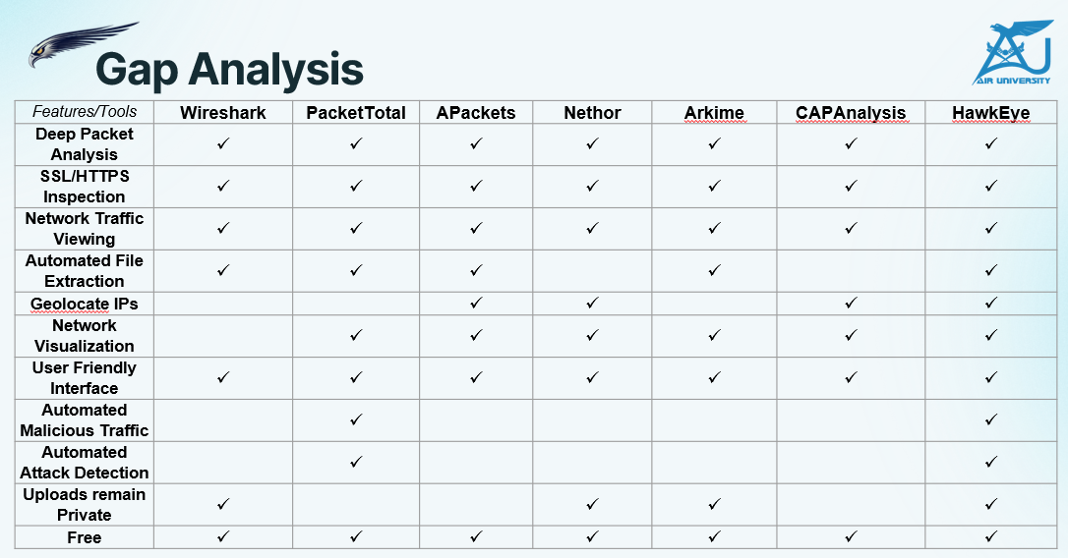
Competitor Analysis

Slide 6
Timeline for Completion

Slide 7

Feasibility Analysis
Product Feasibility
Market Feasibility
HawkEye addresses the need for efficient, user-friendly cybersecurity tools. Concept testing confirmed demand for its features.
Targets underserved SMB segment in the rapidly expanding cybersecurity industry.
Organizational Feasibility
Financial Feasibility
Led by experienced team with expertise in cybersecurity and software development.
Minimal start-up costs due to open-source tools. Subscription-based model ensures steady income.

Slide 8
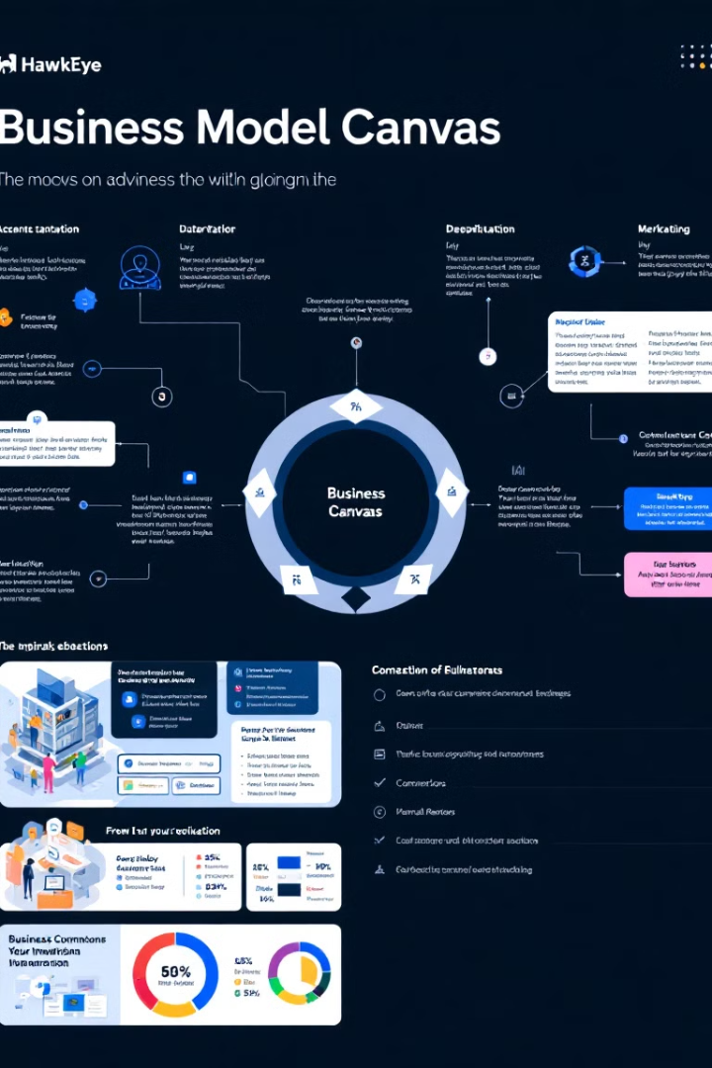




Business Model Development
Revenue Streams
Subscription-based model, business licenses and support services.
Cost Structure
Development, operational, marketing, and scaling costs.
Value Proposition
Affordability, ease of use, efficiency, and scalability for businesses of all sizes.
Customer Segments
SMBs, and cybersecurity teams seeking affordable and efficient solutions.

Slide 9





HawkEye's Key Features
Interactive Network Map
Threat Detection
Visualize network structures and connections.
Identify malicious traffic, domains, and IPs.
Geolocation
User-Friendly Interface
Pinpoint IP addresses on a global map.
Simplified dashboards for easy data interpretation.

Slide 10



Marketing Strategy
Content Marketing
1
White papers, case studies, webinars, tutorials
Partnerships
2
IT service providers, cybersecurity training organizations
Event Marketing
3
Texpos, live demonstrations
HawkEye's marketing strategy focuses on reaching SMBs and cybersecurity professionals through various channels. The approach combines digital presence, educational content, strategic partnerships, and industry events to maximize visibility and adoption.

Slide 11
Product Launch Strategy
Pre-Launch Preparation
1
Product testing, documentation, support setup
Launch Execution
2
Online event, product availability, marketing campaigns
Post-Launch Support
3
Customer feedback, updates, early adopter incentives
The launch strategy for HawkEye is designed to create excitement and ensure a smooth rollout. It includes thorough preparation, a well-executed launch event, and ongoing support to drive adoption and customer satisfaction.

Slide 12

Conclusion: HawkEye's Impact on Cybersecurity
Democratizing Advanced Threat Detection
Enhancing Incident Response
HawkEye makes sophisticated cybersecurity tools accessible to businesses of all sizes.
Automated analysis and user-friendly interfaces speed up threat detection and mitigation.
Driving Industry Innovation
HawkEye's approach challenges the status quo, potentially influencing future cybersecurity solutions.
HawkEye is poised to make a significant impact in the cybersecurity landscape by providing an affordable, efficient, and user-friendly solution for network traffic analysis and threat hunting. Its innovative approach addresses critical needs in the market and has the potential to enhance cybersecurity practices across various industries.

